Slide 1
LINKS IN LINUX

Slide 2
Link
A link is an entry in your file system which connects a file name to the actual bytes of data on the disk. More than one file name can "link" to the same data.

Slide 3
Types of links
There are two types of links:
Hard links : Refer to the specific location of physical data. A hard link is a direct link to the data on disk.
Soft Link or symbolic links or symlink: Refer to a symbolic path indicating the abstract location of another file. A symbolic link (also sometimes known as a soft link) does not link directly to the data on disk but to another link to the data on disk.

Slide 4
Hard link
A hard link is a direct link to the data on disk.
This means data can be accessed directly via an original filename or a hard link.
Both the original file and the hard link are direct links to the data on disk.
The use of a hard link allows multiple filenames to be associated with the same data on disk.
Command used:
link

Slide 5
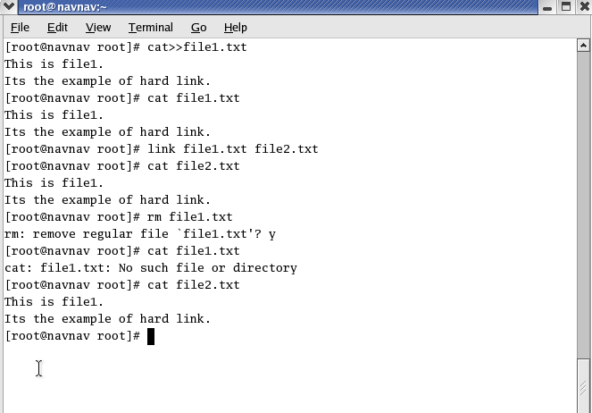

Slide 6
Soft Link
A symbolic link (also sometimes known as a soft link) does not link directly to the data on disk but to another link to the data on disk.
Symbolic links can link across file systems to link a folder on an external hard drive.
Command used:
ln -s

Slide 7
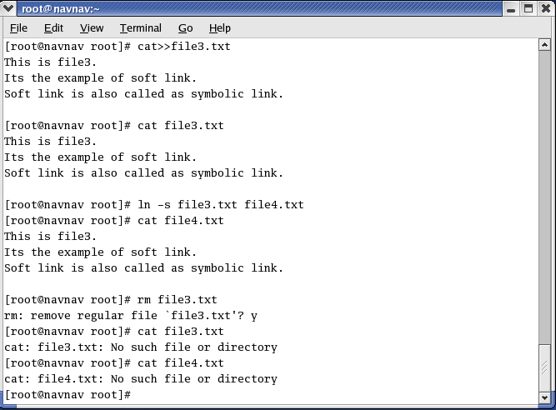

Slide 8
Hard link vs. Soft link in Linux
Hard links cannot link directories.
Cannot cross file system boundaries.
Soft or symbolic links are just like hard links. It allows to associate multiple filenames with a single file. However, symbolic links allows:
To create links between directories.
Can cross file system boundaries.
These links behave differently when the source of the link is moved or removed.
Symbolic links are not updated.
Hard links always refer to the source, even if moved or removed.

